Slide 1
CptS 440 / 540 Artificial Intelligence
Knowledge Representation

Slide 2
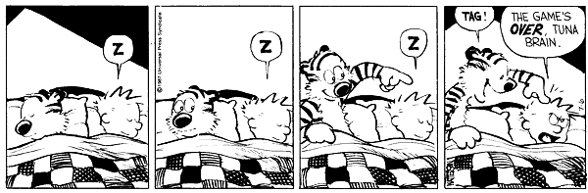
Knowledge Representation

Slide 3
Knowledge Representation
When we use search to solve a problem we must
Capture the knowledge needed to formalize the problem
Apply a search technique to solve problem
Execute the problem solution

Slide 4
Role of KR
The first step is the role of “knowledge representation” in AI.
Formally,
The intended role of knowledge representation in artificial intelligence is to reduce problems of intelligent action to search problems.
A good description, developed within the conventions of a good KR, is an open door to problem solving
A bad description, using a bad representation, is a brick wall preventing problem solving

Slide 5
A Knowledge-Based Agent
We previously talked about applications of search but not about methods of formalizing the problem.
Now we look at extended capabilities to general logical reasoning.
Here is one knowledge representation: logical expressions.
A knowledge-based agent must be able to
Represent states, actions, etc.
Incorporate new percepts
Update internal representations of the world
Deduce hidden properties about the world
Deduce appropriate actions
We will
Describe properties of languages to use for logical reasoning
Describe techniques for deducing new information from current information
Apply search to deduce (or learn) specifically needed information

Slide 6
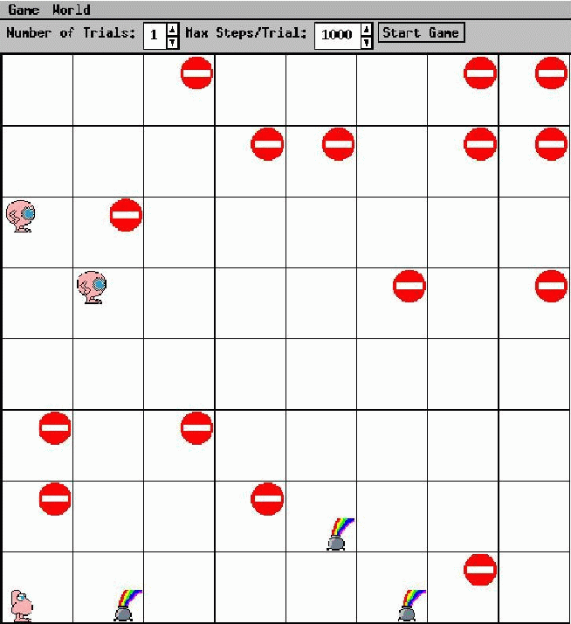
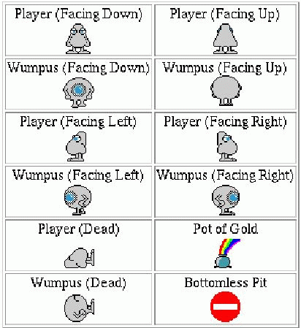
The Wumpus World Environment

Slide 7
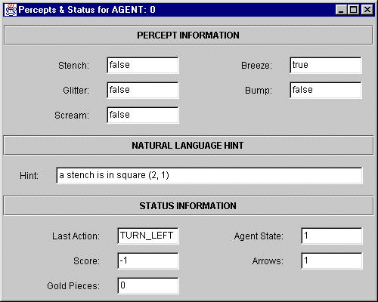
Percepts

Slide 8
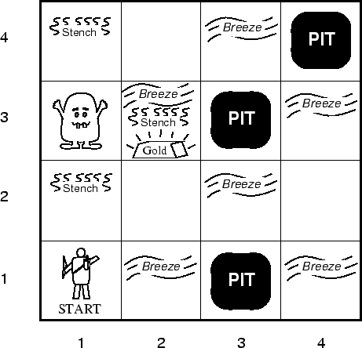
WW Agent Description
Performance measure
gold +1000, death -1000
-1 per step, -10 for using arrow
Environment
Squares adjacent to wumpus are smelly
Squares adjacent to pit are breezy
Glitter iff gold is in same square
Shooting kills wumpus if agent facing it
Shooting uses up only arrow
Grabbing picks up gold if in same square
Releasing drops gold in same square
Actuators
Left turn, right turn, forward, grab, release, shoot
Sensors
Breeze, glitter, smell, bump, scream

Slide 9
WW Environment Properties
Observable?
Partial
Deterministic?
Yes
Episodic?
Sequential
Static?
Yes (for now), wumpus and pits do not move
Discrete?
Yes
Single agent?
Multi (wumpus, eventually other agents)

Slide 10
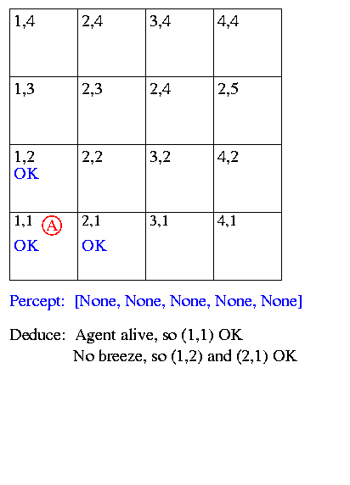
Sample Run

Slide 11
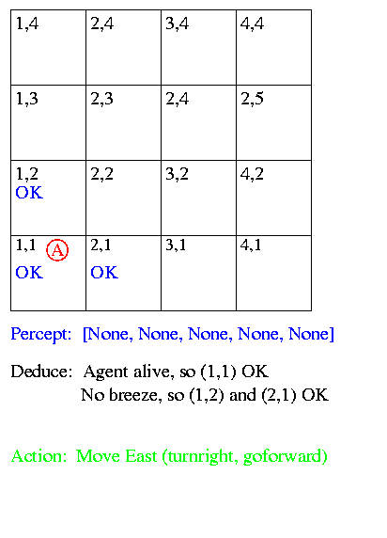
Sample Run

Slide 12
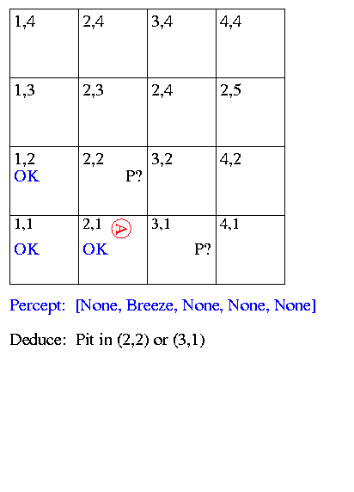
Sample Run

Slide 13
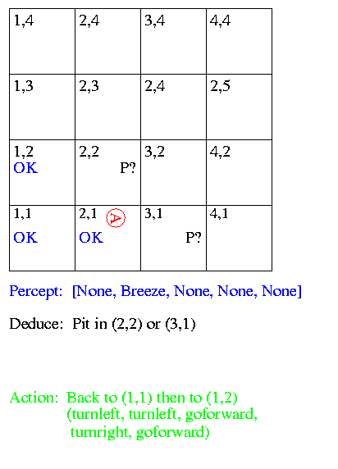
Sample Run

Slide 14
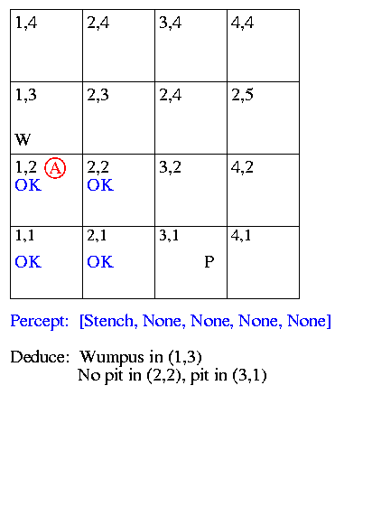
Sample Run

Slide 15
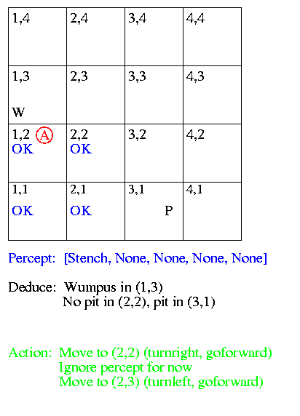
Sample Run

Slide 16
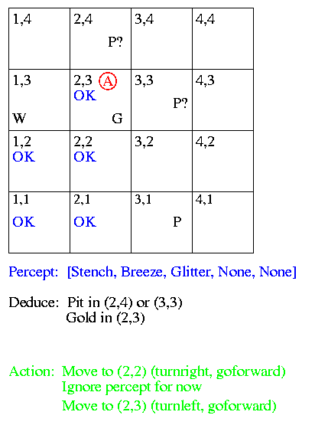
Sample Run

Slide 17
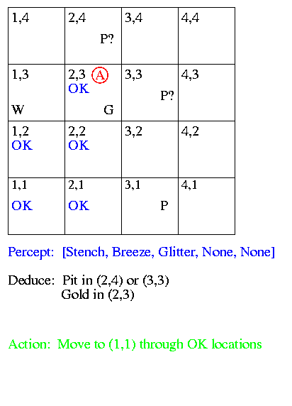
Sample Run

Slide 18
Sample Run
Now we look at
How to represent facts / beliefs
“There is a pit in (2,2) or (3,1)”
How to make inferences
“No breeze in (1,2), so pit in (3,1)”

Slide 19
Representation, Reasoning and Logic
Sentence: Individual piece of knowledge - English sentence forms one piece of knowledge in English language - Statement in C forms one piece of knowledge in C programming language
Syntax: Form used to represent sentences - Syntax of C indicates legal combinations of symbols - a = 2 + 3; is legal
- a = + 2 3 is not legal
- Syntax alone does not indicate meaning
Semantics: Mapping from sentences to facts in the world - They define the truth of a sentence in a “possible world” - Add the values of 2 and 3, store them in the memory location indicated by variable a
In the language of arithmetic:
x + 2 >= y is a sentence x2 + y > is not a sentence x + 2 >= y is true in all worlds where the number x + 2 is
no less than the number y x + 2 >= y is true in a world where
x = 7, y = 1 x + 2 >= y is false in a world where
x = 0, y = 6

Slide 20
Entailment
There can exist a relationship between items in the language
Sentences “entail” sentences (representation level)
Facts “follow” from facts (real world)
Entail / Follow mean the new item is true if the old items are true
A collection of sentences, or knowledge base (KB), entail a sentence
KB |= sentence
KB entails the sentence iff the sentence is true in all worlds where the KB is true
Entails
Sentences
Sentence
Semantics
Semantics
Representation
World
Follows
Facts
Fact

Slide 21
Entailment Examples
KB
The Giants won
The Reds won
Entails
Either the Giants won or the Reds won
KB
To get a perfect score your program must be turned in today
I always get perfect scores
Entails
I turned in my program today
KB
CookLectures -> TodayIsTuesday v TodayIsThursday
- TodayIsThursday
TodayIsSaturday -> SleepLate
Rainy -> GrassIsWet
CookLectures v TodayIsSaturday
- SleepLate
Which of these are correct entailments?
- Sleeplate
GrassIsWet
- SleepLate v GrassIsWet
TodayIsTuesday
True

Slide 22
Models
Logicians frequently use models, which are formally structured worlds with respect to which truth can be evaluated. These are our “possible worlds”.
M is a model of a sentence s if s is true in M.
M(s) is the set of all models of s.
KB entails s (KB |= s) if and only if M(KB) is a subset of M(s)
For example, KB = Giants won and Reds won, s = Giants won

Slide 23
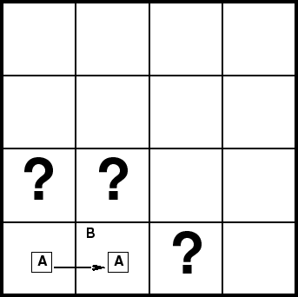
Entailment in the Wumpus World
Situation after detecting nothing in [1,1], moving right, breeze in [2,1]
Consider possible models for the situation (the region around the visited squares) assuming only pits, no wumpi
3 Boolean choices, so there are 8 possible models

Slide 24
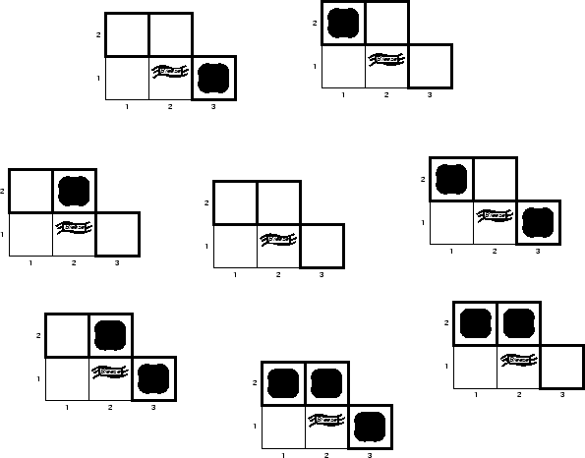
Wumpus Models

Slide 25
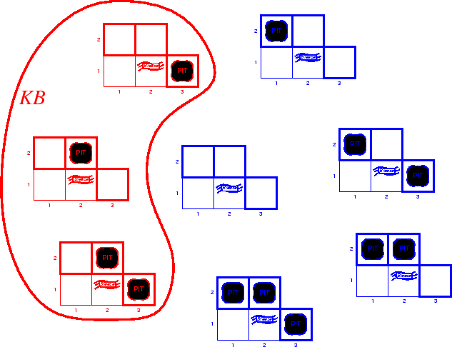
Wumpus Models
KB = wumpus world rules + observations

Slide 26
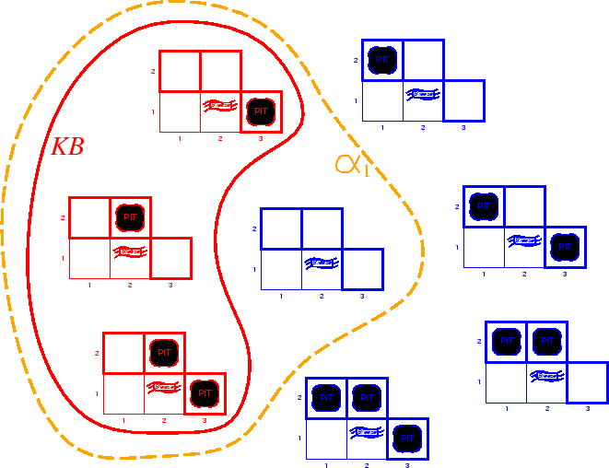
Wumpus Models
KB = wumpus world rules + observations
Possible conclusion: alpha1 = “[1,2] is safe”
KB |= alpha1, proved by model checking

Slide 27
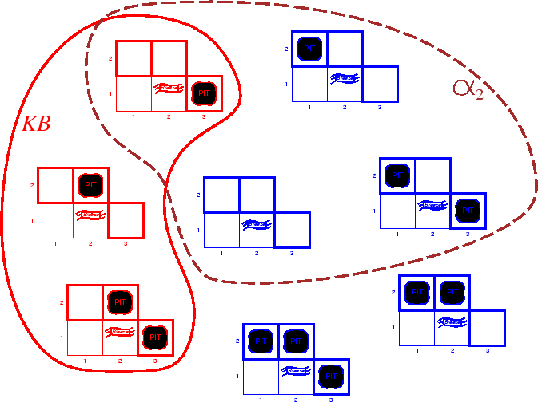
Wumpus Models
KB = wumpus world rules + observations
alpha2 = “[2,2] is safe”, KB |= alpha2

Slide 28
Inference
Use two different ways:
Generate new sentences that are entailed by KB
Determine whether or not sentence is entailed by KB
A sound inference procedure generates only entailed sentences
Modus ponens is sound
Abduction is not sound
Logic gone bad

Slide 29
Definitions
A complete inference procedure can generate all entailed sentences from the knowledge base.
The meaning of a sentence is a mapping onto the world (a model).
This mapping is an interpretation (interpretation of Lisp code).
A sentence is valid (necessarily true, tautology) iff true under all possible interpretations.
A V -A
A could be:
Stench at [1,1]
Today is Monday
2+3=5
These statements are not valid.
A ^ -A
A V B
The last statement is satisfiable, meaning there exists at least one interpretation that makes the statement true. The previous statement is unsatisfiable.

Slide 30
Logics
Logics are formal languages for representing information such that conclusions can be drawn
Logics are characterized by their “primitives” commitments
Ontological commitment: What exists? Facts? Objects? Time? Beliefs?
Epistemological commitment: What are the states of knowledge?
Language | Ontological Commitment | Epistemological Commitment
Propositional logic | facts | true/false/unknown
First-order logic | facts, objects, relations | true/false/unknown
Temporal logic | facts, objects, relations, times | true/false/unknown
Probability theory | facts | value in [0, 1]
Fuzzy logic | degree of truth | known interval value

Slide 31
Examples
Propositional logic
Simple logic
Symbols represent entire facts
Boolean connectives (&, v, ->, <=>, ~)
Propositions (symbols, facts) are either TRUE or FALSE
First-order logic
Extend propositional logic to include variables, quantifiers, functions, objects

Slide 32
Propositional Logic
Proposition symbols P, Q, etc., are sentences
The true/false value of propositions and combinations of propositions can be calculated using a truth table
If P and S are sentences, then so are –P, P^Q, PvQ, P->Q, P<->Q
An interpretation I consists of an assignment of truth values to all proposition symbols I(S)
An interpretation is a logician's word for what is often called a “possible world”
Given 3 proposition symbols P, Q, and R, there are 8 interpretations
Given n proposition symbols, there are 2^{n} interpretations
To determine the truth of a complex statement for I, we can
Substitute I's truth value for every symbol
Use truth tables to reduce the statement to a single truth value
End result is a single truth value, either True or False

Slide 33
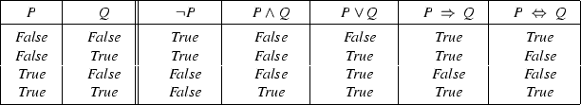
Propositional Logic
For propositional logic, a row in the truth table is one interpretation
A logic is monotonic as long as entailed sentences are preserved as more knowledge is added

Slide 34
Rules of Inference for Propositional Logic
Modus ponens
And introduction
Or introduction
And elimination
Double-negation elimination
Unit resolution
Resolution
All men are mortal (Man -> Mortal)
Socrates is a man (Man)
-----------------------------------------------
Socrates is mortal (Mortal)
Today is Tuesday or Thursday
Today is not Thursday
---------------------------------------
Today is Tuesday
Today is Tuesday or Thursday
Today is not Thursday or tomorrow is Friday
----------------------------------------------------------
Today is Tuesday or tomorrow is Friday

Slide 35
Normal Forms
Other approaches to inference use syntactic operations on sentences, often expressed in standardized forms
Conjunctive Normal Form (CNF) conjunction of disjunctions of literals (conjunction of clauses) For example, (A v –B) ^ (B v –C v –D)
Disjunctive Normal Form (DNF) disjunction of conjunctions of literals (disjunction of terms) For example, (A ^ B) v (A ^ -C) v (A ^ -D) v (-B ^ -C) v (-B ^ -D)
Horn Form (restricted) conjunction of Horn clauses (clauses with <= 1 positive literal) For example, (A v –B) ^ (B v –C v –D) Often written as a set of implications: B -> A and (C ^ D) -> B

Slide 36
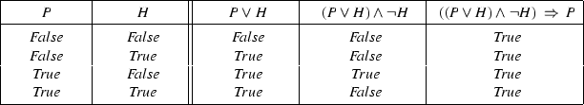
Proof methods
Model checking
Truth table enumeration (sound and complete for propositional logic)
Show that all interpretations in which the left hand side of the rule is true, the right hand side is also true
Application of inference rules
Sound generation of new sentences from old Proof = a sequence of inference rule applications Can use inference rules as operators in a standard search algorithm

Slide 37
Wumpus World KB
Vocabulary
Let P_{i,j} be true if there is a pit in [i,j]
Let B_{i,j} be true if there is a breeze in [i,j]
Sentences
-P_{1,1}
-B_{1,1}
B_{2,1}
“Pits cause breezes in adjacent squres”
B_{1,1} <-> P_{1,2} v P_{2,1}
B_{2,1} <-> P_{1,1} v P_{2,2} v P_{3,1}

Slide 38
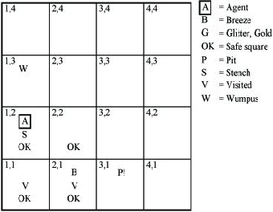
An Agent for the Wumpus World
Imagine we are at a stage in the game where we have had some experience
What is in our knowledge base?
What can we deduce about the world?
Example: Finding the wumpus
If we are in [1,1] and know
-S11
S12
S21
-S11 -> -W11 & -W12 & -W21
S12 -> W11 v W12 v W13 v W22
S21 -> W11 v W21 v W31 v W22
What can we conclude?
Notes:
-W11
-W12
-W21
W11 v W12 v W13 v W22
W11 v W21 v W31 v W22
W13 v W22
W31 v W22

Slide 39
Limitations of Propositional Logic
Propositional logic cannot express general-purpose knowledge succinctly
We need 32 sentences to describe the relationship between wumpi and stenches
We would need another 32 sentences for pits and breezes
We would need at least 64 sentences to describe the effects of actions
How would we express the fact that there is only one wumpus?
Difficult to identify specific individuals (Mary, among 3)
Generalizations, patterns, regularities difficult to represent (all triangles have 3 sides)

Slide 40
First-Order Predicate Calculus
Propositional Logic uses only propositions (symbols representing facts), only possible values are True and False
First-Order Logic includes:
Objects: peoples, numbers, places, ideas (atoms)
Relations: relationships between objects (predicates, T/F value)
Example: father(fred, mary)
Properties: properties of atoms (predicates, T/F value) Example: red(ball)
Functions: father-of(mary), next(3), (any value in range)
Constant: function with no parameters, MARY

Slide 41
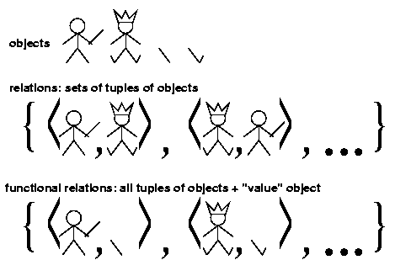
FOPC Models

Slide 42
Example
Express “Socrates is a man” in
Propositional logic
MANSOCRATES - single proposition representing entire idea
First-Order Predicate Calculus
Man(SOCRATES) - predicate representing property of constant SOCRATES

Slide 43
FOPC Syntax
Constant symbols (Capitalized, Functions with no arguments) Interpretation must map to exactly one object in the world
Predicates (can take arguments, True/False) Interpretation maps to relationship or property T/F value
Function (can take arguments) Maps to exactly one object in the world

Slide 44
Definitions
Term Anything that identifies an object Function(args) Constant - function with 0 args
Atomic sentence Predicate with term arguments Enemies(WilyCoyote, RoadRunner) Married(FatherOf(Alex), MotherOf(Alex))
Literals atomic sentences and negated atomic sentences
Connectives (&), (v), (->), (<=>), (~) if connected by , conjunction (components are conjuncts) if connected by , disjunction (components are disjuncts)
Quantifiers Universal Quantifier Existential Quantifier

Slide 45
Universal Quantifiers
How do we express “All unicorns speak English” in Propositional Logic?
We would need to specify a proposition for each unicorn
is used to express facts and relationships that we know to be true for all members of a group (objects in the world)
A variable is used in the place of an object x Unicorn(x) -> SpeakEnglish(x) The domain of x is the world The scope of x is the statement following (sometimes in [])
Same as specifying
Unicorn(Uni1) -> SpeakEnglish(Uni1) &
Unicorn(Uni2) -> SpeakEnglish(Uni2) &
Unicorn(Uni3) -> SpeakEnglish(Uni3) &
...
Unicorn(Table1) -> Table(Table1) &
...
One statement for each object in the world
We will leave variables lower case (sometimes ?x) Notice that x ranges over all objects, not just unicorns.
A term with no variables is a ground term

Slide 46
Existential Quantifier
This makes a statement about some object (not named)
x [Bunny(x) ^ EatsCarrots(x)]
This means there exists some object in the world (at least one) for which the statement is true. Same as disjunction over all objects in the world.
(Bunny(Bun1) & EatsCarrots(Bun1)) v
(Bunny(Bun2) & EatsCarrots(Bun2)) v
(Bunny(Bun3) & EatsCarrots(Bun3)) v
...
(Bunny(Table1) & EatsCarrots(Table1)) v
...
What about x Unicorn(x) -> SpeakEnglish(x)?
Means implication applies to at least one object in the universe

Slide 47
DeMorgan Rules
Example:

Slide 48
Other Properties
(X->Y) <-> -XvY
Can prove with truth table
Not true:
(X->Y) <-> (Y->X)
This is a type of inference that is not sound (abduction)

Slide 49
Examples
All men are mortal

Slide 50
Examples
All men are mortal
x [Man(x) -> Mortal(x)]

Slide 51
Examples
All men are mortal
x [Man(x) -> Mortal(x)]
Socrates is a man

Slide 52
Examples
All men are mortal
x [Man(x) -> Mortal(x)]
Socrates is a man
Man(Socrates)

Slide 53
Examples
All men are mortal
x [Man(x) -> Mortal(x)]
Socrates is a man
Man(Socrates)
Socrates is mortal
Mortal(Socrates)

Slide 54
Examples
All men are mortal
x [Man(x) -> Mortal(x)]
Socrates is a man
Man(Socrates)
Socrates is mortal
Mortal(Socrates)
All purple mushrooms are poisonous

Slide 55
Examples
All men are mortal
x [Man(x) -> Mortal(x)]
Socrates is a man
Man(Socrates)
Socrates is mortal
Mortal(Socrates)
All purple mushrooms are poisonous
x [(Purple(x) ^ Mushroom(x)) -> Poisonous(x)]

Slide 56
Examples
All men are mortal
x [Man(x) -> Mortal(x)]
Socrates is a man
Man(Socrates)
Socrates is mortal
Mortal(Socrates)
All purple mushrooms are poisonous
x [(Purple(x) ^ Mushroom(x)) -> Poisonous(x)]
A mushroom is poisonous only if it is purple

Slide 57
Examples
All men are mortal
x [Man(x) -> Mortal(x)]
Socrates is a man
Man(Socrates)
Socrates is mortal
Mortal(Socrates)
All purple mushrooms are poisonous
x [(Purple(x) ^ Mushroom(x)) -> Poisonous(x)]
A mushroom is poisonous only if it is purple

Slide 58
Examples
All men are mortal
x [Man(x) -> Mortal(x)]
Socrates is a man
Man(Socrates)
Socrates is mortal
Mortal(Socrates)
All purple mushrooms are poisonous
x [(Purple(x) ^ Mushroom(x)) -> Poisonous(x)]
A mushroom is poisonous only if it is purple
x [(Mushroom(x) ^ Poisonous(x)) -> Purple(x)]

Slide 59
Examples
All men are mortal
x [Man(x) -> Mortal(x)]
Socrates is a man
Man(Socrates)
Socrates is mortal
Mortal(Socrates)
All purple mushrooms are poisonous
x [(Purple(x) ^ Mushroom(x)) -> Poisonous(x)]
A mushroom is poisonous only if it is purple
x [(Mushroom(x) ^ Poisonous(x)) -> Purple(x)]
No purple mushroom is poisonous

Slide 60
Examples
All men are mortal
x [Man(x) -> Mortal(x)]
Socrates is a man
Man(Socrates)
Socrates is mortal
Mortal(Socrates)
All purple mushrooms are poisonous
x [(Purple(x) ^ Mushroom(x)) -> Poisonous(x)]
A mushroom is poisonous only if it is purple
x [(Mushroom(x) ^ Poisonous(x)) -> Purple(x)]
No purple mushroom is poisonous
-( x [Purple(x) ^ Mushroom(x) ^ Poisonous(x)])

Slide 61
Examples
There is exactly one mushroom

Slide 62
Examples
There is exactly one mushroom
Because “exactly one” is difficult to express we can use ! To denote exactly one of a type of object
Every city has a dog catcher who has been bitten by every dog in town

Slide 63
Examples
There is exactly one mushroom
Because “exactly one” is difficult to express we can use ! To denote exactly one of a type of object
Every city has a dog catcher who has been bitten by every dog in town
Use City(c), DogCatcher(c), Bit(d,x), Lives(x,c)

Slide 64
Examples
No human enjoys golf

Slide 65
Examples
No human enjoys golf
Some professor that is not a historian writes programs

Slide 66
Examples
No human enjoys golf
Some professor that is not a historian writes programs
Every boy owns a dog

Slide 67
Examples
No human enjoys golf
Some professor that is not a historian writes programs
Every boy owns a dog
Do these mean the same thing?
Brothers are siblings
“Sibling” is reflexive and symmetric
One’s mother is one’s female parent
A first cousin is a child of a parent’s sibling

Slide 68
Higher-Order Logic
FOPC quantifies over objects in the universe.
Higher-order logic quantifies over relations and functions as well as objects.
All functions with a single argument return a value of 1
x, y [Equal(x(y), 1)]
Two objects are equal iff all properties applied to them are equivalent
x, y [(x=y) <-> ( p [p(x) <-> p(y)])]
Note that we use “=“ as a shorthand for equal, meaning they are in fact the same object

Slide 69
Additional Operators
Existential Elimination
v [..v..]
Substitute k for v anywhere in sentence, where k is a constant (term with no arguments) and does not already appear in the sentence (Skolemization)
Existential Introduction
If [..g..] true (where g is ground term)
then v [..v..] true (v is substituted for g)
Universal Elimination
x [..x..]
Substitute M for x throughout entire sentence, where M is a constant and does not already appear in the sentence

Slide 70
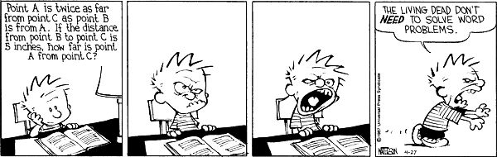
Example Proof
Known:
If x is a parent of y, then x is older than y
x,y [Parent(x,y) -> Older(x,y)]
If x is the mother of y, then x is a parent of y
x,y [Mother(x,y) -> Parent(x,y)]
Lulu is the mother of Fifi
Mother(Lulu, Fifi)
Prove: Lulu is older than Fifi (Older(Lulu, Fifi))
Parent(Lulu, Fifi)
2,3, Universal Elimination, Modus Ponens
Older(Lulu, Fifi)
1,4, Universal Elimination, Modus Ponens
We “bind” the variable to a constant

Slide 71
Example Proof
The law says that it is a crime for an American to sell weapons to hostile nations.
FAx,y,z[(American(x)&Weapon(y)&Nation(z)&Hostile(z)&Sells(x,z,y)) -> Criminal(x)]

Slide 72
Example Proof
The law says that it is a crime for an American to sell weapons to hostile nations. The country Nono, an enemy of America, has some missiles, and all of its missiles were sold to it by Colonel West, who is an American.
FAx,y,z[(American(x)&Weapon(y)&Nation(z)&Hostile(z)&Sells(x,z,y)) -> Criminal(x)]
EX x [Owns(Nono,x) & Missile(x)]

Slide 73
Example Proof
The law says that it is a crime for an American to sell weapons to hostile nations. The country Nono, an enemy of America, has some missiles, and all of its missiles were sold to it by Colonel West, who is an American.
FAx,y,z[(American(x)&Weapon(y)&Nation(z)&Hostile(z)& Sells(x,z,y)) -> Criminal(x)]
EX x [Owns(Nono,x) & Missile(x)]
FA x [Owns(Nono,x) & Missile(x)) -> Sells(West, Nono,x)]
FA x [Missile(x) -> Weapon(x)]
FA x [Enemy(x,America) -> Hostile(x)]
American(West)
Nation(Nono)
Enemy(Nono, America)
Nation(America)
Prove: West is a criminal.

Slide 74
Prove: West is a Criminal
FAx,y,z[(American(x)& Weapon(y)&Nation(z)& Hostile(z)& Sells(x,z,y)) -> Criminal(x)]
EX x [Owns(Nono,x) & Missile(x)]
FA x [Owns(Nono,x) & Missile(x)) -> Sells(West, Nono,x)]
FA x [Missile(x) -> Weapon(x)]
FA x [Enemy(x,America) -> Hostile(x)]
American(West)
Nation(Nono)
Enemy(Nono, America)
Nation(America)
Owns(Nono,M1) & Missile(M1)
2 & Existential Elimination

Slide 75
Prove: West is a Criminal
FAx,y,z[(American(x)& Weapon(y)&Nation(z)& Hostile(z)& Sells(x,z,y)) -> Criminal(x)]
EX x [Owns(Nono,x) & Missile(x)]
FA x [Owns(Nono,x) & Missile(x)) -> Sells(West, Nono,x)]
FA x [Missile(x) -> Weapon(x)]
FA x [Enemy(x,America) -> Hostile(x)]
American(West)
Nation(Nono)
Enemy(Nono, America)
Nation(America)
Owns(Nono,M1) & Missile(M1)
Owns(Nono, M1)
10 & And Elimination

Slide 76
Prove: West is a Criminal
FAx,y,z[(American(x)& Weapon(y)&Nation(z)& Hostile(z)& Sells(x,z,y)) -> Criminal(x)]
EX x [Owns(Nono,x) & Missile(x)]
FA x [Owns(Nono,x) & Missile(x)) -> Sells(West, Nono,x)]
FA x [Missile(x) -> Weapon(x)]
FA x [Enemy(x,America) -> Hostile(x)]
American(West)
Nation(Nono)
Enemy(Nono, America)
Nation(America)
Owns(Nono,M1) & Missile(M1)
Owns(Nono, M1)
Missile(M1)
10 & And Elimination

Slide 77
Prove: West is a Criminal
FAx,y,z[(American(x)& Weapon(y)&Nation(z)& Hostile(z)& Sells(x,z,y)) -> Criminal(x)]
EX x [Owns(Nono,x) & Missile(x)]
FA x [Owns(Nono,x) & Missile(x)) -> Sells(West, Nono,x)]
FA x [Missile(x) -> Weapon(x)]
FA x [Enemy(x,America) -> Hostile(x)]
American(West)
Nation(Nono)
Enemy(Nono, America)
Nation(America)
Owns(Nono,M1) & Missile(M1)
Owns(Nono, M1)
Missile(M1)
Missile(M1) -> Weapon(M1)
4 & Universal Elimination
Universal Elimination
FORALL v []
If true for universal variable v,
then true for a ground term
(term with no variables)

Slide 78
Prove: West is a Criminal
FAx,y,z[(American(x)& Weapon(y)&Nation(z)& Hostile(z)& Sells(x,z,y)) -> Criminal(x)]
EX x [Owns(Nono,x) & Missile(x)]
FA x [Owns(Nono,x) & Missile(x)) -> Sells(West, Nono,x)]
FA x [Missile(x) -> Weapon(x)]
FA x [Enemy(x,America) -> Hostile(x)]
American(West)
Nation(Nono)
Enemy(Nono, America)
Nation(America)
Owns(Nono,M1) & Missile(M1)
Owns(Nono, M1)
Missile(M1)
Missile(M1) -> Weapon(M1)
Weapon(M1)
12, 13, Modus Ponens

Slide 79
Prove: West is a Criminal
FAx,y,z[(American(x)& Weapon(y)&Nation(z)& Hostile(z)& Sells(x,z,y)) -> Criminal(x)]
EX x [Owns(Nono,x) & Missile(x)]
FA x [Owns(Nono,x) & Missile(x)) -> Sells(West, Nono,x)]
FA x [Missile(x) -> Weapon(x)]
FA x [Enemy(x,America) -> Hostile(x)]
American(West)
Nation(Nono)
Enemy(Nono, America)
Nation(America)
Owns(Nono,M1) & Missile(M1)
Owns(Nono, M1)
Missile(M1)
Missile(M1) -> Weapon(M1)
Weapon(M1)
Owns(Nono,M1) & Missile(M1) -> Sells(West,Nono,M1)
3 & Universal Elimination

Slide 80
Prove: West is a Criminal
FAx,y,z[(American(x)& Weapon(y)&Nation(z)& Hostile(z)& Sells(x,z,y)) -> Criminal(x)]
EX x [Owns(Nono,x) & Missile(x)]
FA x [Owns(Nono,x) & Missile(x)) -> Sells(West, Nono,x)]
FA x [Missile(x) -> Weapon(x)]
FA x [Enemy(x,America) -> Hostile(x)]
American(West)
Nation(Nono)
Enemy(Nono, America)
Nation(America)
Owns(Nono,M1) & Missile(M1)
Owns(Nono, M1)
Missile(M1)
Missile(M1) -> Weapon(M1)
Weapon(M1)
Owns(Nono,M1) & Missile(M1) -> Sells(West,Nono,M1)
Sells(West,Nono,M1)
10, 15, Modus Ponens

Slide 81
Prove: West is a Criminal
FAx,y,z[(American(x)& Weapon(y)&Nation(z)& Hostile(z)& Sells(x,z,y)) -> Criminal(x)]
EX x [Owns(Nono,x) & Missile(x)]
FA x [Owns(Nono,x) & Missile(x)) -> Sells(West, Nono,x)]
FA x [Missile(x) -> Weapon(x)]
FA x [Enemy(x,America) -> Hostile(x)]
American(West)
Nation(Nono)
Enemy(Nono, America)
Nation(America)
Owns(Nono,M1) & Missile(M1)
Owns(Nono, M1)
Missile(M1)
Missile(M1) -> Weapon(M1)
Weapon(M1)
Owns(Nono,M1) & Missile(M1) -> Sells(West,Nono,M1)
Sells(West,Nono,M1)
American(West) & Weapon(M1) & Nation(Nono) & Hostile(Nono) & Sells(West,Nono,M1) -> Criminal(West)
1, Universal Elimination (x West) (y M1) (z Nono)

Slide 82
Prove: West is a Criminal
FAx,y,z[(American(x)& Weapon(y)&Nation(z)& Hostile(z)& Sells(x,z,y)) -> Criminal(x)]
EX x [Owns(Nono,x) & Missile(x)]
FA x [Owns(Nono,x) & Missile(x)) -> Sells(West, Nono,x)]
FA x [Missile(x) -> Weapon(x)]
FA x [Enemy(x,America) -> Hostile(x)]
American(West)
Nation(Nono)
Enemy(Nono, America)
Nation(America)
Owns(Nono,M1) & Missile(M1)
Owns(Nono, M1)
Missile(M1)
Missile(M1) -> Weapon(M1)
Weapon(M1)
Owns(Nono,M1) & Missile(M1) -> Sells(West,Nono,M1)
Sells(West,Nono,M1)
American(West) & Weapon(M1) & Nation(Nono) & Hostile(Nono) & Sells(West,Nono,M1) -> Criminal(West)
Enemy(Nono,America) -> Hostile(Nono)
5, Universal Elimination

Slide 83
Prove: West is a Criminal
FAx,y,z[(American(x)& Weapon(y)&Nation(z)& Hostile(z)& Sells(x,z,y)) -> Criminal(x)]
EX x [Owns(Nono,x) & Missile(x)]
FA x [Owns(Nono,x) & Missile(x)) -> Sells(West, Nono,x)]
FA x [Missile(x) -> Weapon(x)]
FA x [Enemy(x,America) -> Hostile(x)]
American(West)
Nation(Nono)
Enemy(Nono, America)
Nation(America)
Owns(Nono,M1) & Missile(M1)
Owns(Nono, M1)
Missile(M1)
Missile(M1) -> Weapon(M1)
Weapon(M1)
Owns(Nono,M1) & Missile(M1) -> Sells(West,Nono,M1)
Sells(West,Nono,M1)
American(West) & Weapon(M1) & Nation(Nono) & Hostile(Nono) & Sells(West,Nono,M1) -> Criminal(West)
Enemy(Nono,America) -> Hostile(Nono)
Hostile(Nono)
8, 18, Modus Ponens

Slide 84
Prove: West is a Criminal
FAx,y,z[(American(x)& Weapon(y)&Nation(z)& Hostile(z)& Sells(x,z,y)) -> Criminal(x)]
EX x [Owns(Nono,x) & Missile(x)]
FA x [Owns(Nono,x) & Missile(x)) -> Sells(West, Nono,x)]
FA x [Missile(x) -> Weapon(x)]
FA x [Enemy(x,America) -> Hostile(x)]
American(West)
Nation(Nono)
Enemy(Nono, America)
Nation(America)
Owns(Nono,M1) & Missile(M1)
Owns(Nono, M1)
Missile(M1)
Missile(M1) -> Weapon(M1)
Weapon(M1)
Owns(Nono,M1) & Missile(M1) -> Sells(West,Nono,M1)
Sells(West,Nono,M1)
American(West) & Weapon(M1) & Nation(Nono) & Hostile(Nono) & Sells(West,Nono,M1) -> Criminal(West)
Enemy(Nono,America) -> Hostile(Nono)
Hostile(Nono)
American(West) & Weapon(M1) & Nation(Nono) & Hostile(Nono) & Sells(West,Nono,M1)
6, 7, 14, 16, 19, And Introduction

Slide 85
Prove: West is a Criminal
FAx,y,z[(American(x)& Weapon(y)&Nation(z)& Hostile(z)& Sells(x,z,y)) -> Criminal(x)]
EX x [Owns(Nono,x) & Missile(x)]
FA x [Owns(Nono,x) & Missile(x)) -> Sells(West, Nono,x)]
FA x [Missile(x) -> Weapon(x)]
FA x [Enemy(x,America) -> Hostile(x)]
American(West)
Nation(Nono)
Enemy(Nono, America)
Nation(America)
Owns(Nono,M1) & Missile(M1)
Owns(Nono, M1)
Missile(M1)
Missile(M1) -> Weapon(M1)
Weapon(M1)
Owns(Nono,M1) & Missile(M1) -> Sells(West,Nono,M1)
Sells(West,Nono,M1)
American(West) & Weapon(M1) & Nation(Nono) & Hostile(Nono) & Sells(West,Nono,M1) -> Criminal(West)
Enemy(Nono,America) -> Hostile(Nono)
Hostile(Nono)
American(West) & Weapon(M1) & Nation(Nono) & Hostile(Nono) & Sells(West,Nono,M1)
Criminal(West)
17, 20, Modus Ponens

Slide 86
FOPC and the Wumpus World
Perception rules
b,g,t Percept([Smell,b,g],t) -> Smelled(t)
Here we are indicating a Percept occurring at time t
s,b,t Percept([s,b,Glitter],t) -> AtGold(t)
We can use FOPC to write rules for selecting actions:
Reflex agent: t AtGold(t) -> Action(Grab, t)
Reflex agent with internal state: t AtGold(t) & -Holding(Gold,t) -> Action(Grab, t)
Holding(Gold,t) cannot be observed, so keeping track of change is essential

Slide 87
Deducing Hidden Properties
Properties of locations:
Squares are breezy near a pit
Diagnostic rule: infer cause from effect
y Breezy(y) -> x Pit(x) & Adjacent(x,y)
Causal rule: infer effect from cause
x,y Pit(x) & Adjacent(x,y) -> Breezy(y)
Neither of these is complete
For example, causal rule doesn’t say whether squares far away from pits can be breezy
Definition for Breezy predicate
Breezy(y) <-> [ Pit(x) & Adjacent(x,y)]

Slide 88
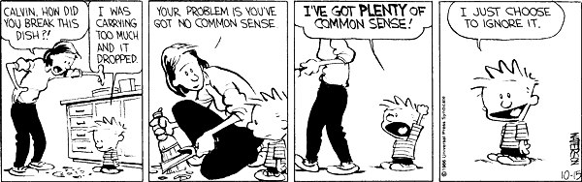
Inference As Search
Operators are inference rules
States are sets of sentences
Goal test checks state to see if it contains query sentence
AI, UE, MP a common inference pattern, but generate a huge branching factor
We need a single, more powerful inference rule

Slide 89
Generalized Modus Ponens
If we have a rule
p1(x) & p2(x) & p3(x,y) & p4(y) & p5(x,y) -> q(x,y)
Each p involves universal / existential quantifiers
Assume each antecedent appears in KB
p1(WSU)
p2(WSU)
p3(WSU, Washington)
p4(Washington)
p5(WSU, Washington)
If we find a way to “match” the variables
Then we can infer q(WSU, Washington)

Slide 90
GMP Example
Rule: Missile(x) & Owns(Nono, x) -> Sells(West, Nono,x)
KB contains
Missile(M1)
Owns(Nono,M1)
To apply, GMP, make sure instantiations of x are the same
Variable matching process is called unification

Slide 91
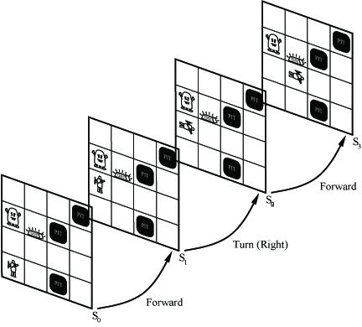
Keeping Track Of Change
Facts hold in situations, rather than forever
Example, Holding(Gold,Now) rather than Holding(Gold)
Situation calculus is one way to represent change in FOPC
Adds a situation argument to each time-dependent predicate
Example, Now in Holding(Gold,Now) denotes a situation
Situations are connected by the Result function
Result(a,s) is the situation that results from applying action a in s

Slide 92
Describing Actions
Effect axiom: describe changes due to action
s AtGold(s) -> Holding(Gold, Result(Grab, s))
Frame axiom--describe non-changes due to action
s HaveArrow(s) -> HaveArrow(Result(Grab, s))
Frame problem: find an elegant way to handle non-change (a) Representation--avoid frame axioms (b) Inference--avoid repeated ``copy-overs'' to keep track of state
Qualification problem : true descriptions of real actions require endless caveats - what if gold is slippery or nailed down or …
Ramification problem : real actions have many secondary consequences - what about the dust on the gold, wear and tear on gloves, …

Slide 93
Describing Actions
Successor-state axioms solve the representational frame problem
Each axiom is about a predicate (not an action per se)
P true afterwords <->
[an action made P true
v P true already and no action made P false]
For holding the gold
a,s Holding(Gold, Result(a,s)) <-> ((a = Grab & AtGold(s)) v (Holding(gold,s) & a != Release))

Slide 94
Generating Plans
Initial condition in KB
At(Agent, [1,1], S0)
At(Gold, [1,2], S0)
Query
Ask(KB, s Holding(Gold,s))
In what situation will I be holding the gold?
Answer: {s/Result(Grab, Result(Forward, S0))}
Go forward and then grab the gold
This assumes that the agent is interested in plans starting at S0 and that S0 is the only situation described in the KB

Slide 95
Generating Plans: A Better Way
Represent plans as action sequences [a1, a2, .., an}
PlanResult(p,s) is the result of execute p (an action sequence) in s
Then query Ask(KB, p Holding(Gold,PlanResult(p, S0)) has solution {p/[Forward, Grab]}
Definition of PlanResult in terms of Result:
s PlanResult([], s) = s
a,p,s PlanResult([a|p], s) = PlanResult(p, Result(a,s))
Planning systems are special-purpose reasoners designed to do this type of inference more efficiently than a general-purpose reasoner

